Slide 1
Navigating a Cybersecurity Incident

Slide 2
THREAT SUMMARY
Summary of Situation:
Hospital A, Hospital B, and Hospital C can not access their centralized log management systems. A message is shown on the screen asking for a ransom to unlock the system.
the attack starts when one of the employees of the technology department opens an email attachment resource.
Asset: The control systems used to monitor patient stats and doctors’ report feature was inaccessible Also the log analysis tool was no longer accessible.
Impact: The Whole CIA triad being impacted
Threat Actor:
external threat: A financially-motivated threat group called FIN4
internal threat: The employee who interacted with the attachment unintentionally caused the incident.
Threat Actor Motivation: Motivated by financial gain.
Common Threat Actor Techniques: Phishing: Spearphishing Attachment.

Slide 3
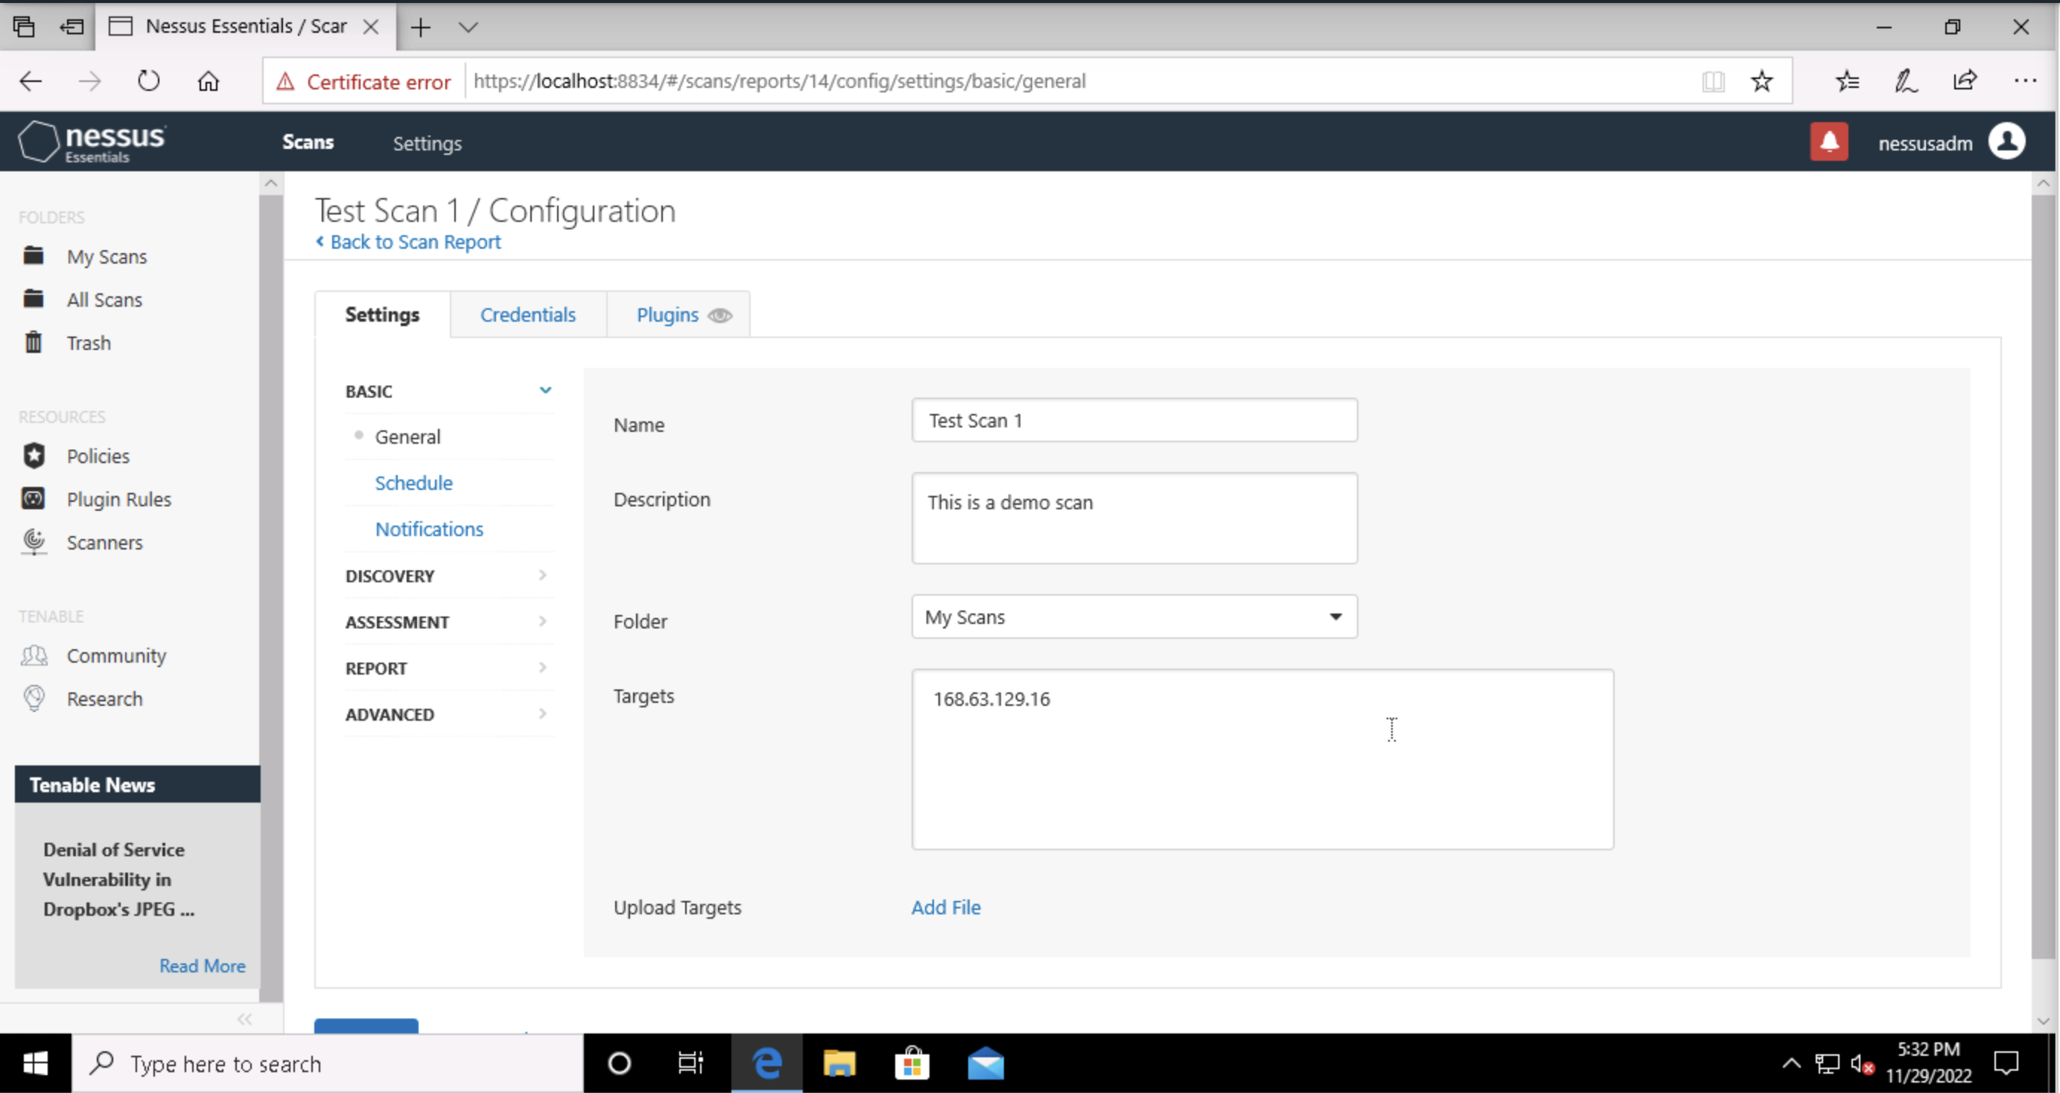
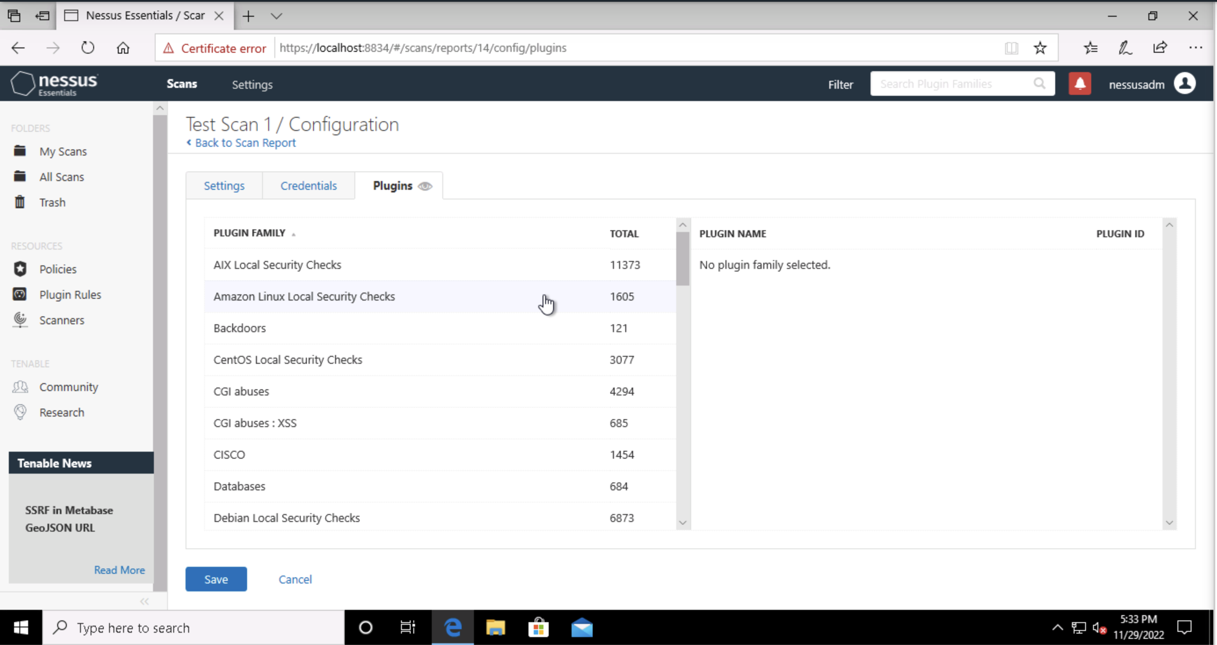
VULNERABILITY SCANNING TARGETS
Summary of scan targets:
Number of devices scanned: One device
Device type: Windows virtual machine
Primary purpose of device: General purpose machine

Slide 4
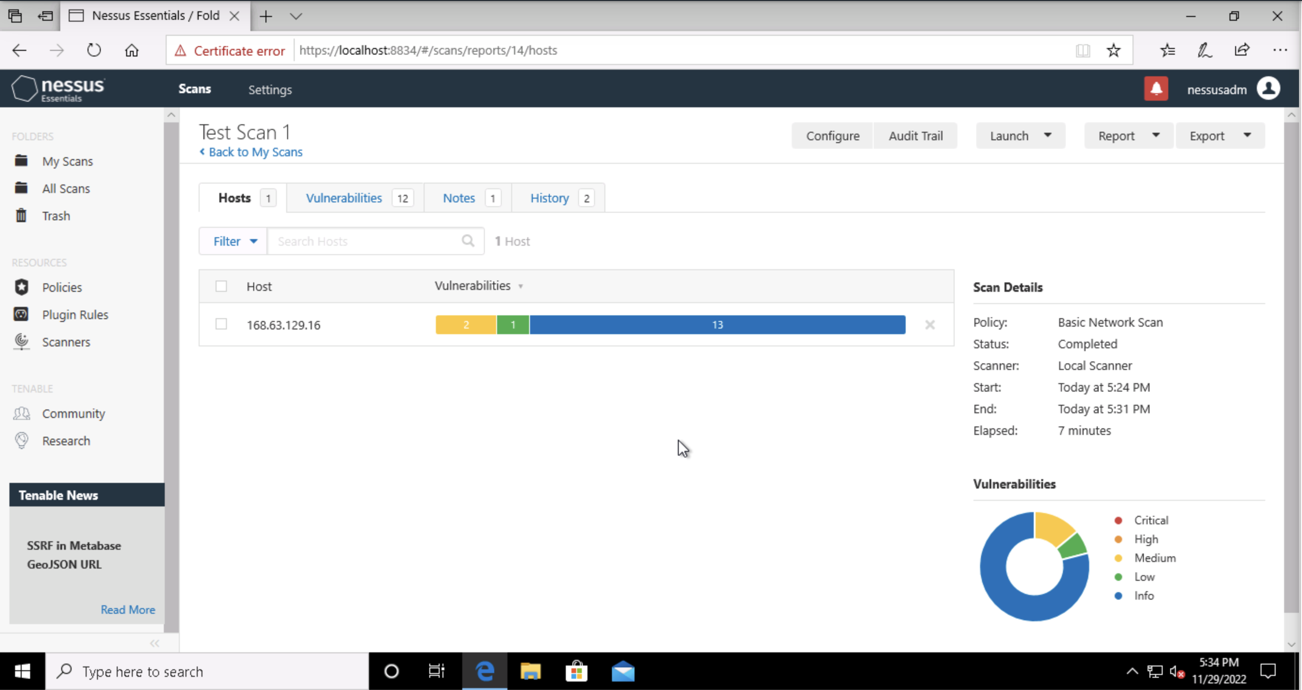
VULNERABILITY SCAN RESULTS
Summary of findings:
Total number of actionable findings: 12
Critical: 0
High: 0
Medium: 2
Low: 1

Slide 5
REMEDIATION RECOMMENDATION
Fix within 30 days
Finding | Severity Rating | Recommended Fix
DNS cache poisoning | Medium | Upgrade to the latest version of BIND
DNS server spoofed request amplification DDoS | Medium | restrict access to your dns server from public network or reconfigure it to reject such queries
Fix within 60 days
Finding | Severity Rating | Recommended Fix
DHCP Server Detection | Low | Apply filtering to hide this information
CVE-1999-0024
CVE-2006-0987

Slide 6
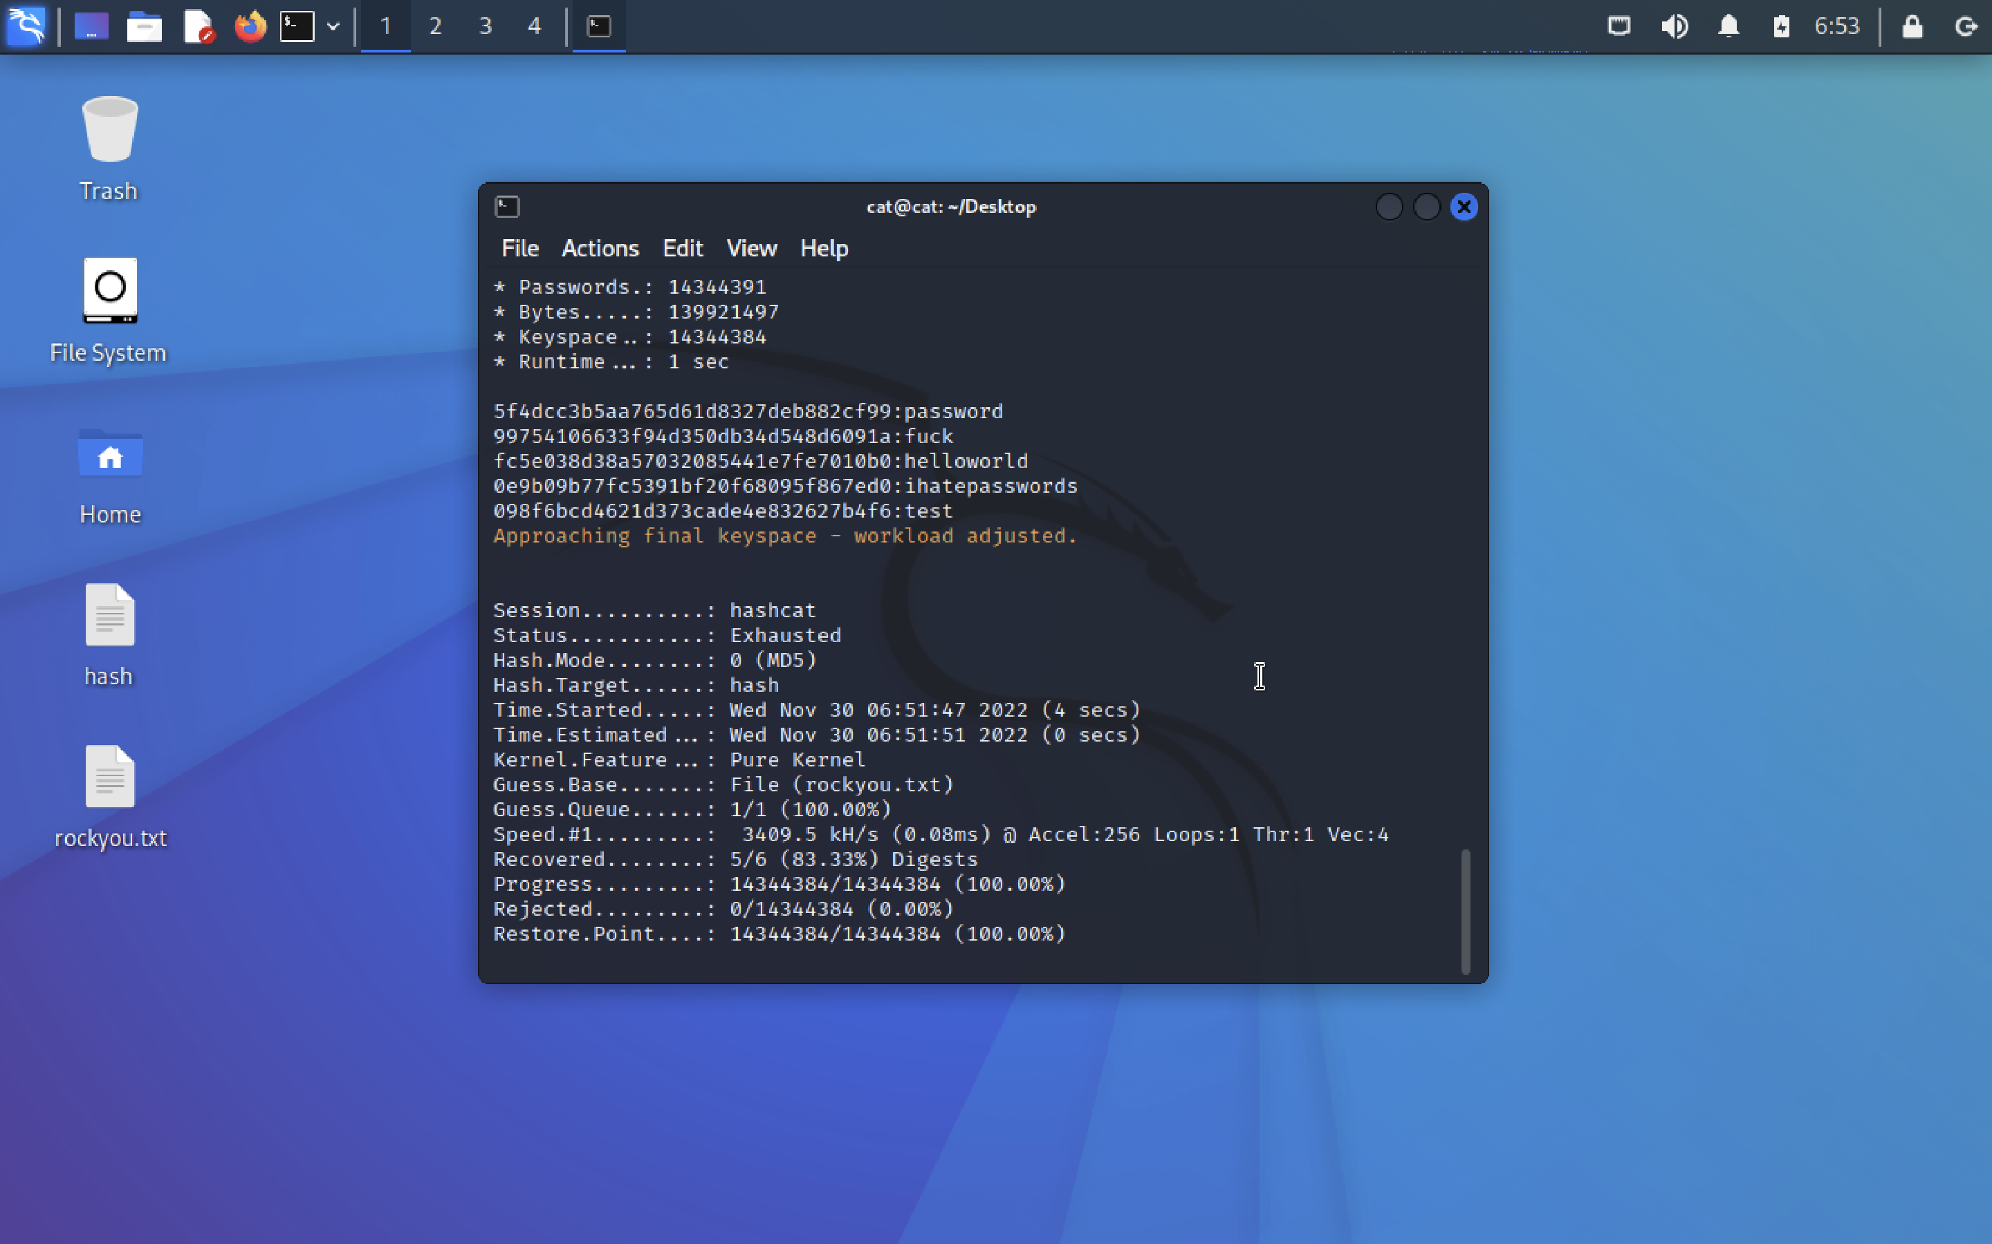
PASSWORD PENETRATION TEST OUTCOME
Methodology: I download the rockyou password list and prepare hash file and use hashcat tool.
command hashcat –a 0 –m 0 hash.txt rockyou.txt
flag –a 0 mean: Dictionary attack
flag –m 0 mean: MD5 Algorithm
Number of passwords tested: 41
Number of passwords cracked: 5
Evidence of weak passwords:
Recommended steps to improve passwords security:
Use combination of symbols, numbers and letters
Password length at least 12
Password age 90 days

Slide 7
INCIDENT RESPONSE PRELIMINARY ASSESSMENT
Summarize ongoing incident:
The system was hit by a ransomware attack resulting in encrypting of all system files and preventing doctors, nurses, and administrative staff from accessing the system.
the attacker asks for 1 million USD in bitcoin for the decryption key.
Document actions or notes from the following steps of the initial incident response checklist
Step 1: The incident was discovered by the hospital staff
Step 2: The ransom message was the indicator of compromise
Step 3: The incident was confirmed, and we lose access to the system
Step 4: Start to gather all groups to respond to the incident
Step5: Don't respond to the attacker or try to pay the ransom
Step 6: Investigate the source of the attack if it is insider or external

Slide 8
INCIDENT RESPONSE RECOMMENDED ACTION
Summarize recommendation to contain, eradicate, and recover:
Starting by isolating the affected devices and preparing for the backup phase.
After that remove any persistent points and train employees to prevent future incidents.
Finally Document all steps and lessons to better respond in future.
Documented actions and notes from the IR checklist
Step 7: Disconnect the affected devices from the network
Step 8: ensuring Business continuity by preparing temporal procedures
Step 9: Restore for the recent backup
Step 10: Remove any persistent points for the attacker in the system network
Step 11: Employee training to prevent future incidents
Step 12: Document all steps and lessons to better respond in future

